Slide 1
Regular Expression

Slide 2
Any language which is accepted by finite automata is called as a regular language and it is represented by regular expression
Examples:
{1010} RE: 1010
{10,1010} RE : 10+1010
{€, 0,00,000,…} RE: 0*
{0,00,000} RE : 0+ or 00*
Operations on Regular Language :
+ (union),
. (concatenation) ,
* (cleen closure)
Expression written using these set of operators and describing a regular language is known as regular expression

Slide 3
Precedence and associativity of the regular-expression operators
The regular-expression operator star has the highest precedence and is left associative.
The regular-expression operator concatenation has the next highest precedence and is left associative.
The regular-expression operator + has the lowest precedence and is left associative.
Thus the regular expression a + b*c would be grouped a + ((b*)c).

Slide 4
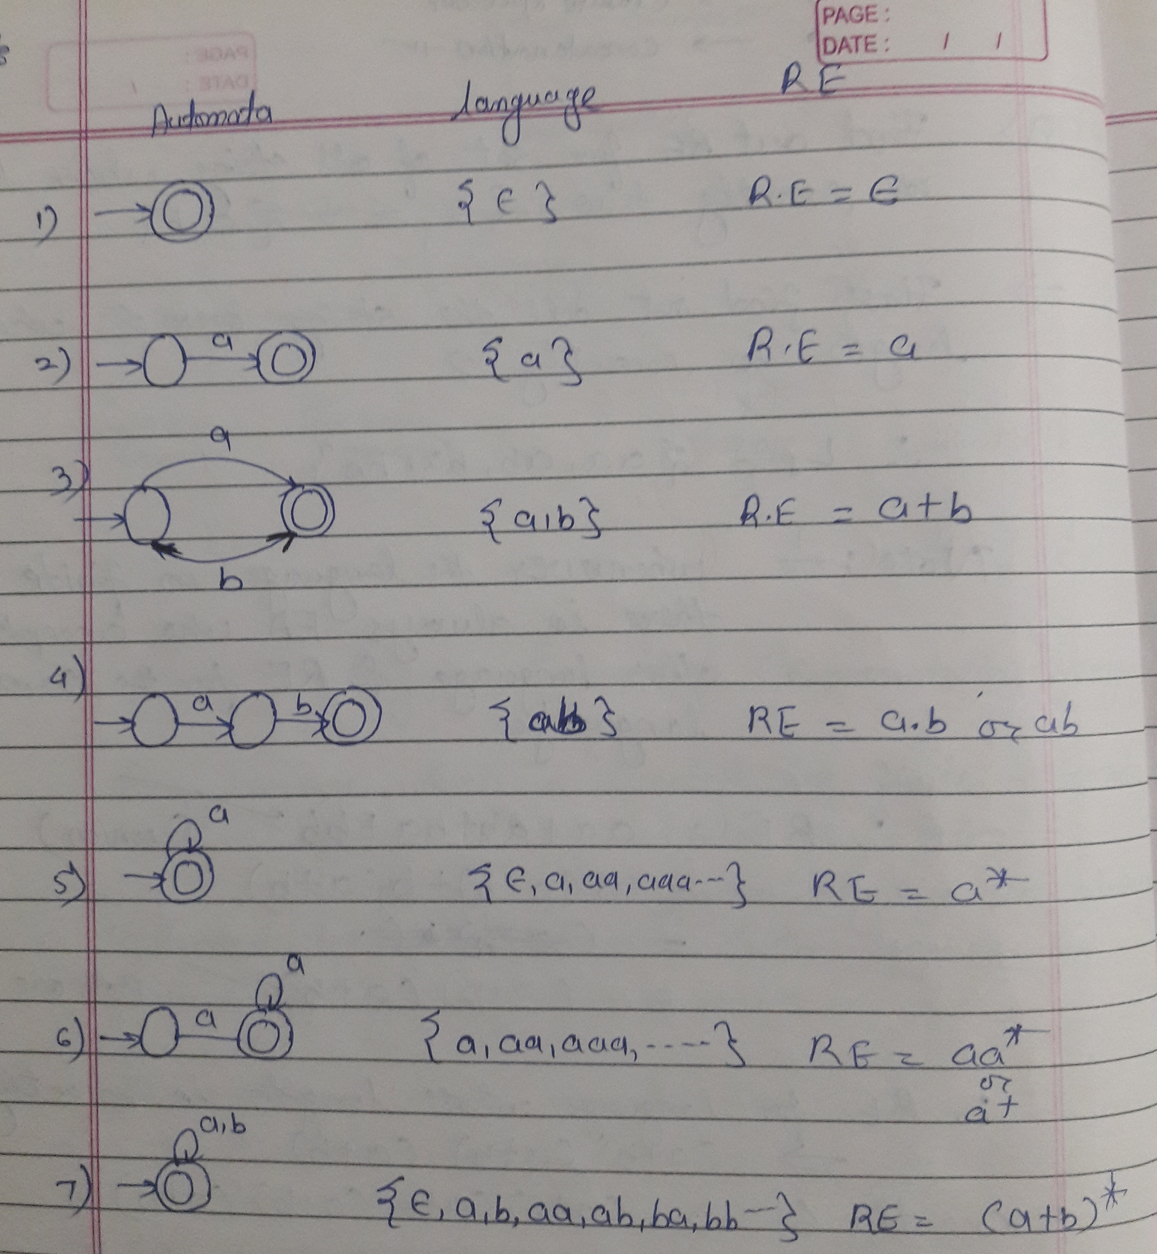

Slide 5
Let E and F be regular expressions denoting the languages L(E) and L(F), respectively.
E + F is a regular expression that denotes L(E) ∪ L(F).
EF is a regular expression that denotes L(E)L(F), the concatenation of L(E) and L(F).
E* is a regular expression that denotes (L(E))*.
(E) is a regular expression that denotes L(E).

Slide 6
1. The set of strings over {0,1} that end in 3 consecutive 1's.
L ={ 111, 0111, 1111, 10111....}
RE: (0 | 1)* 111
2. The set of strings over {0,1} that have at least one 1.
L={01,10,001,100,010.... }
RE: 0* 1 (0 | 1)*
3. L consisting of only even number of 1’s including empty string
L = {ε, 11, 1111, 111111, ……….}
RE: (11)*
4. L consisting of even number of 1’s including empty string
L = {ε, 11,011,110, 1111, 0101, 111111, ……….} RE: (0* 1 0* 1 0*)*
5. strings of a’s and b’s ending with the string abb.
L = {abb, aabb, babb, aaabb, ababb, …………..}
RE : (a+b)*abb

Slide 7
1. Write the regular expression for the language accepting all the string which are starting with 1 and ending with 0, over ∑ = {0, 1}.
Solution: R = 1 (0+1)* 0
2. Write the regular expression for the language starting and ending with a and having any having any combination of b's in between.
Solution: R = a b* b
3. Write the regular expression for the language starting with a but not having consecutive b's.
Solution: L = {a, aba, aab, aba, aaa, abab, .....}
R = {a + ab}*
4. Write the regular expression for the language accepting all the string in which any number of a's is followed by any number of b's is followed by any number of c's.
Solution: R = a* b* c*

Slide 8
Home Work
RE denoting the set of all strings of 0's and 1's containing a single 1.
RE denoting the set of all strings of 0's and 1's containing at least one 1.
RE denoting the set of all strings of 0's and 1's containing an even number of 0's.
RE denoting the set of all strings of a's and b's containing the substring abba or the substring baab (or both).

Slide 9
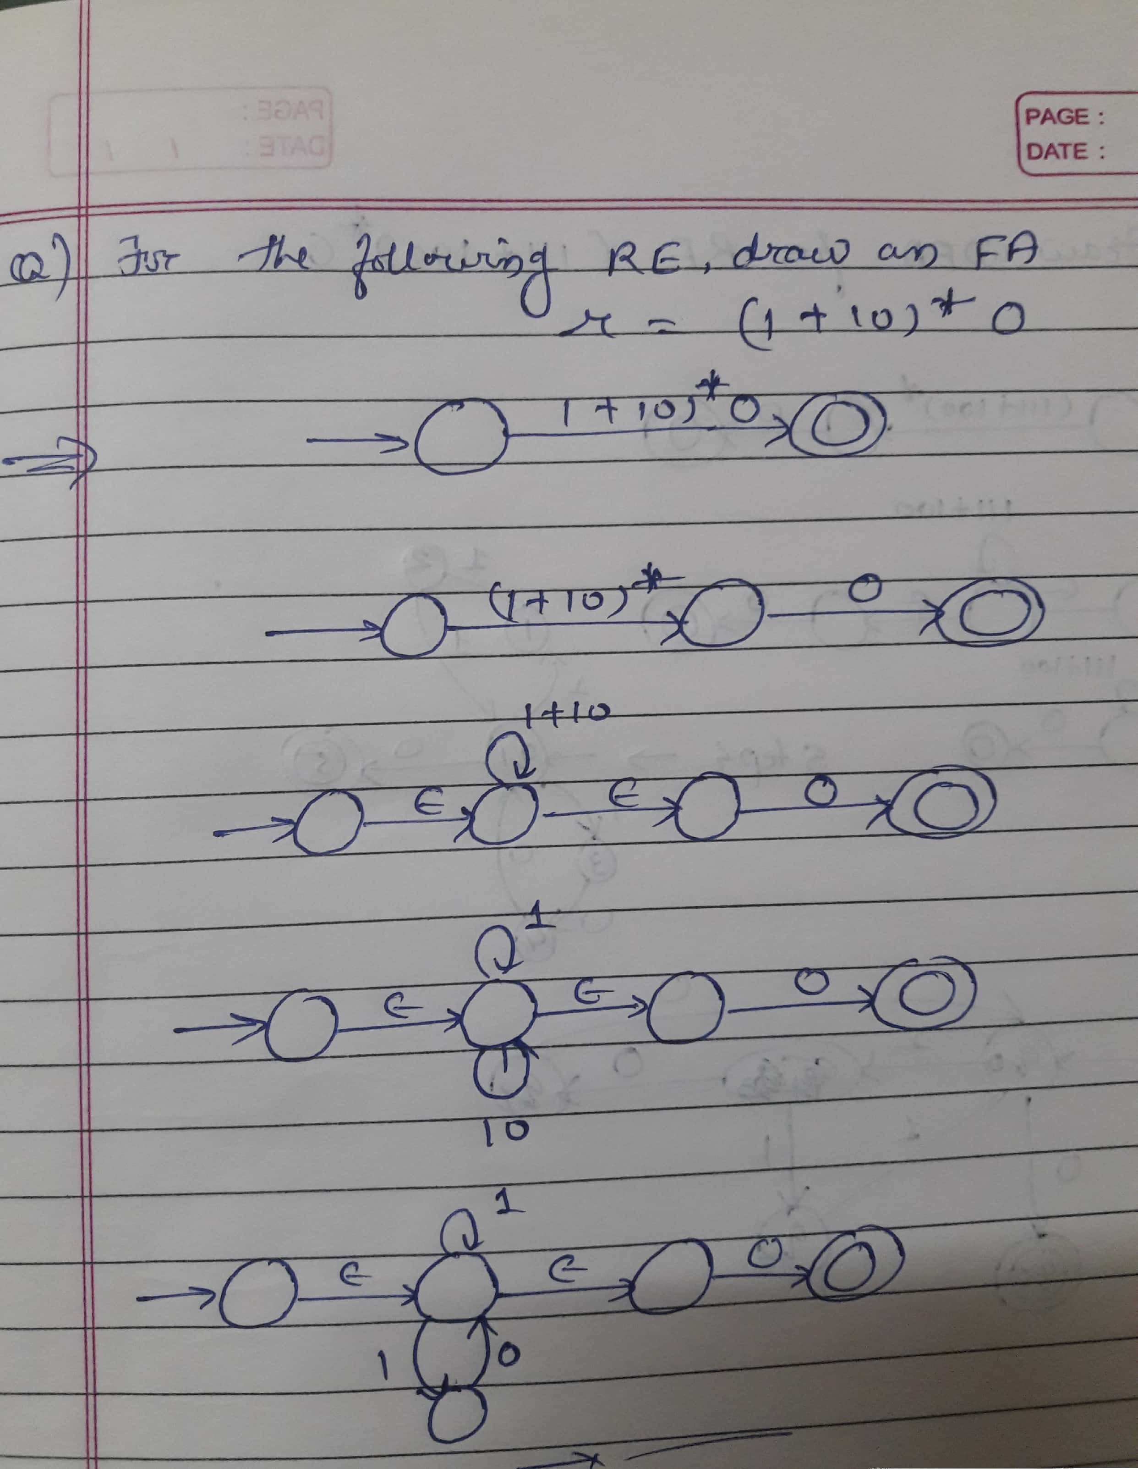

Slide 10
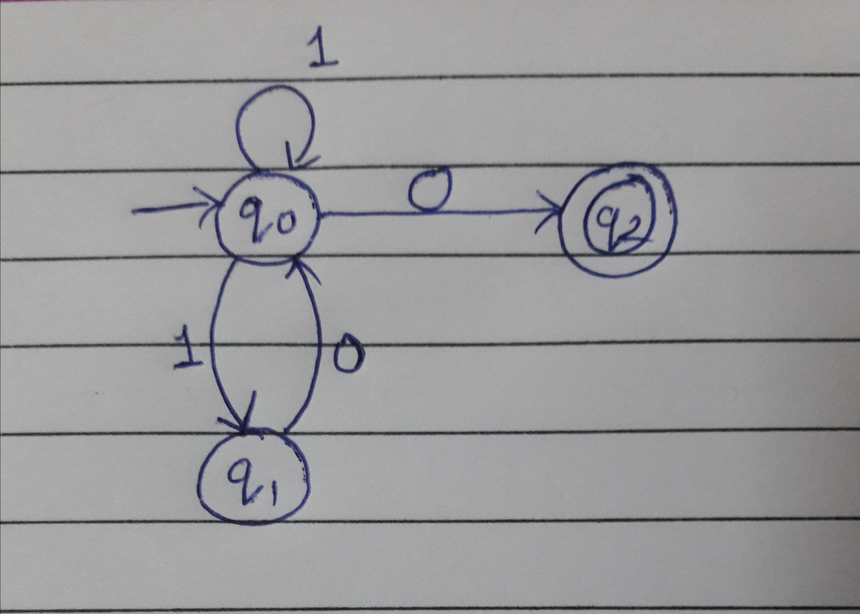

Slide 11
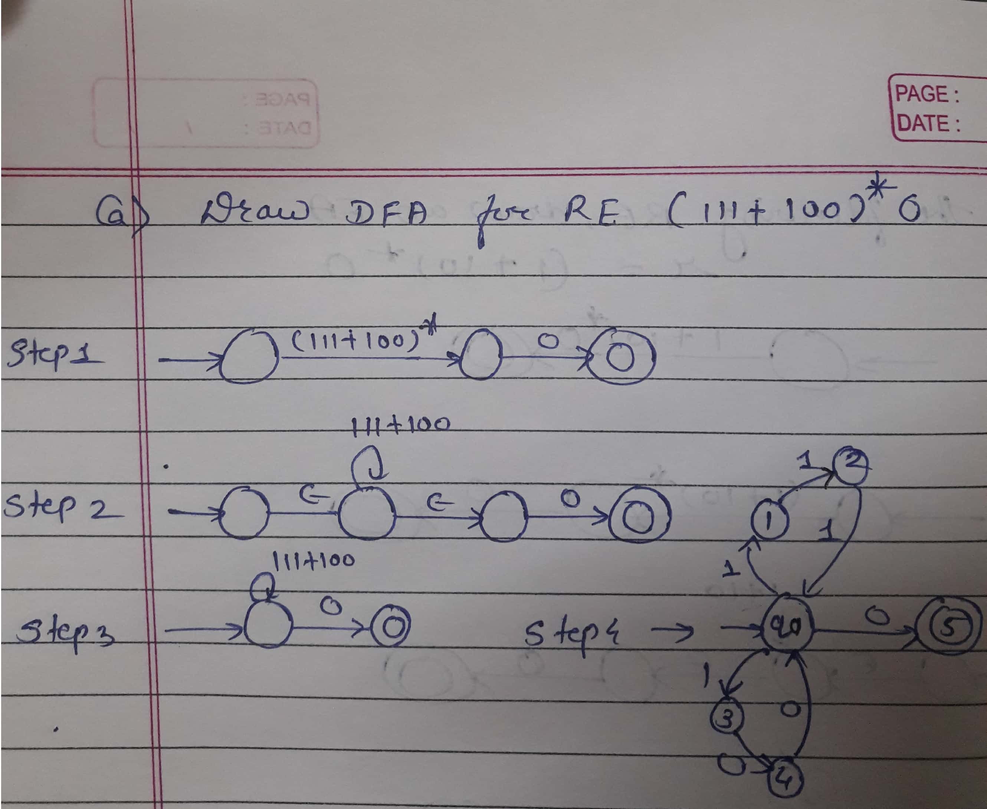

Slide 12
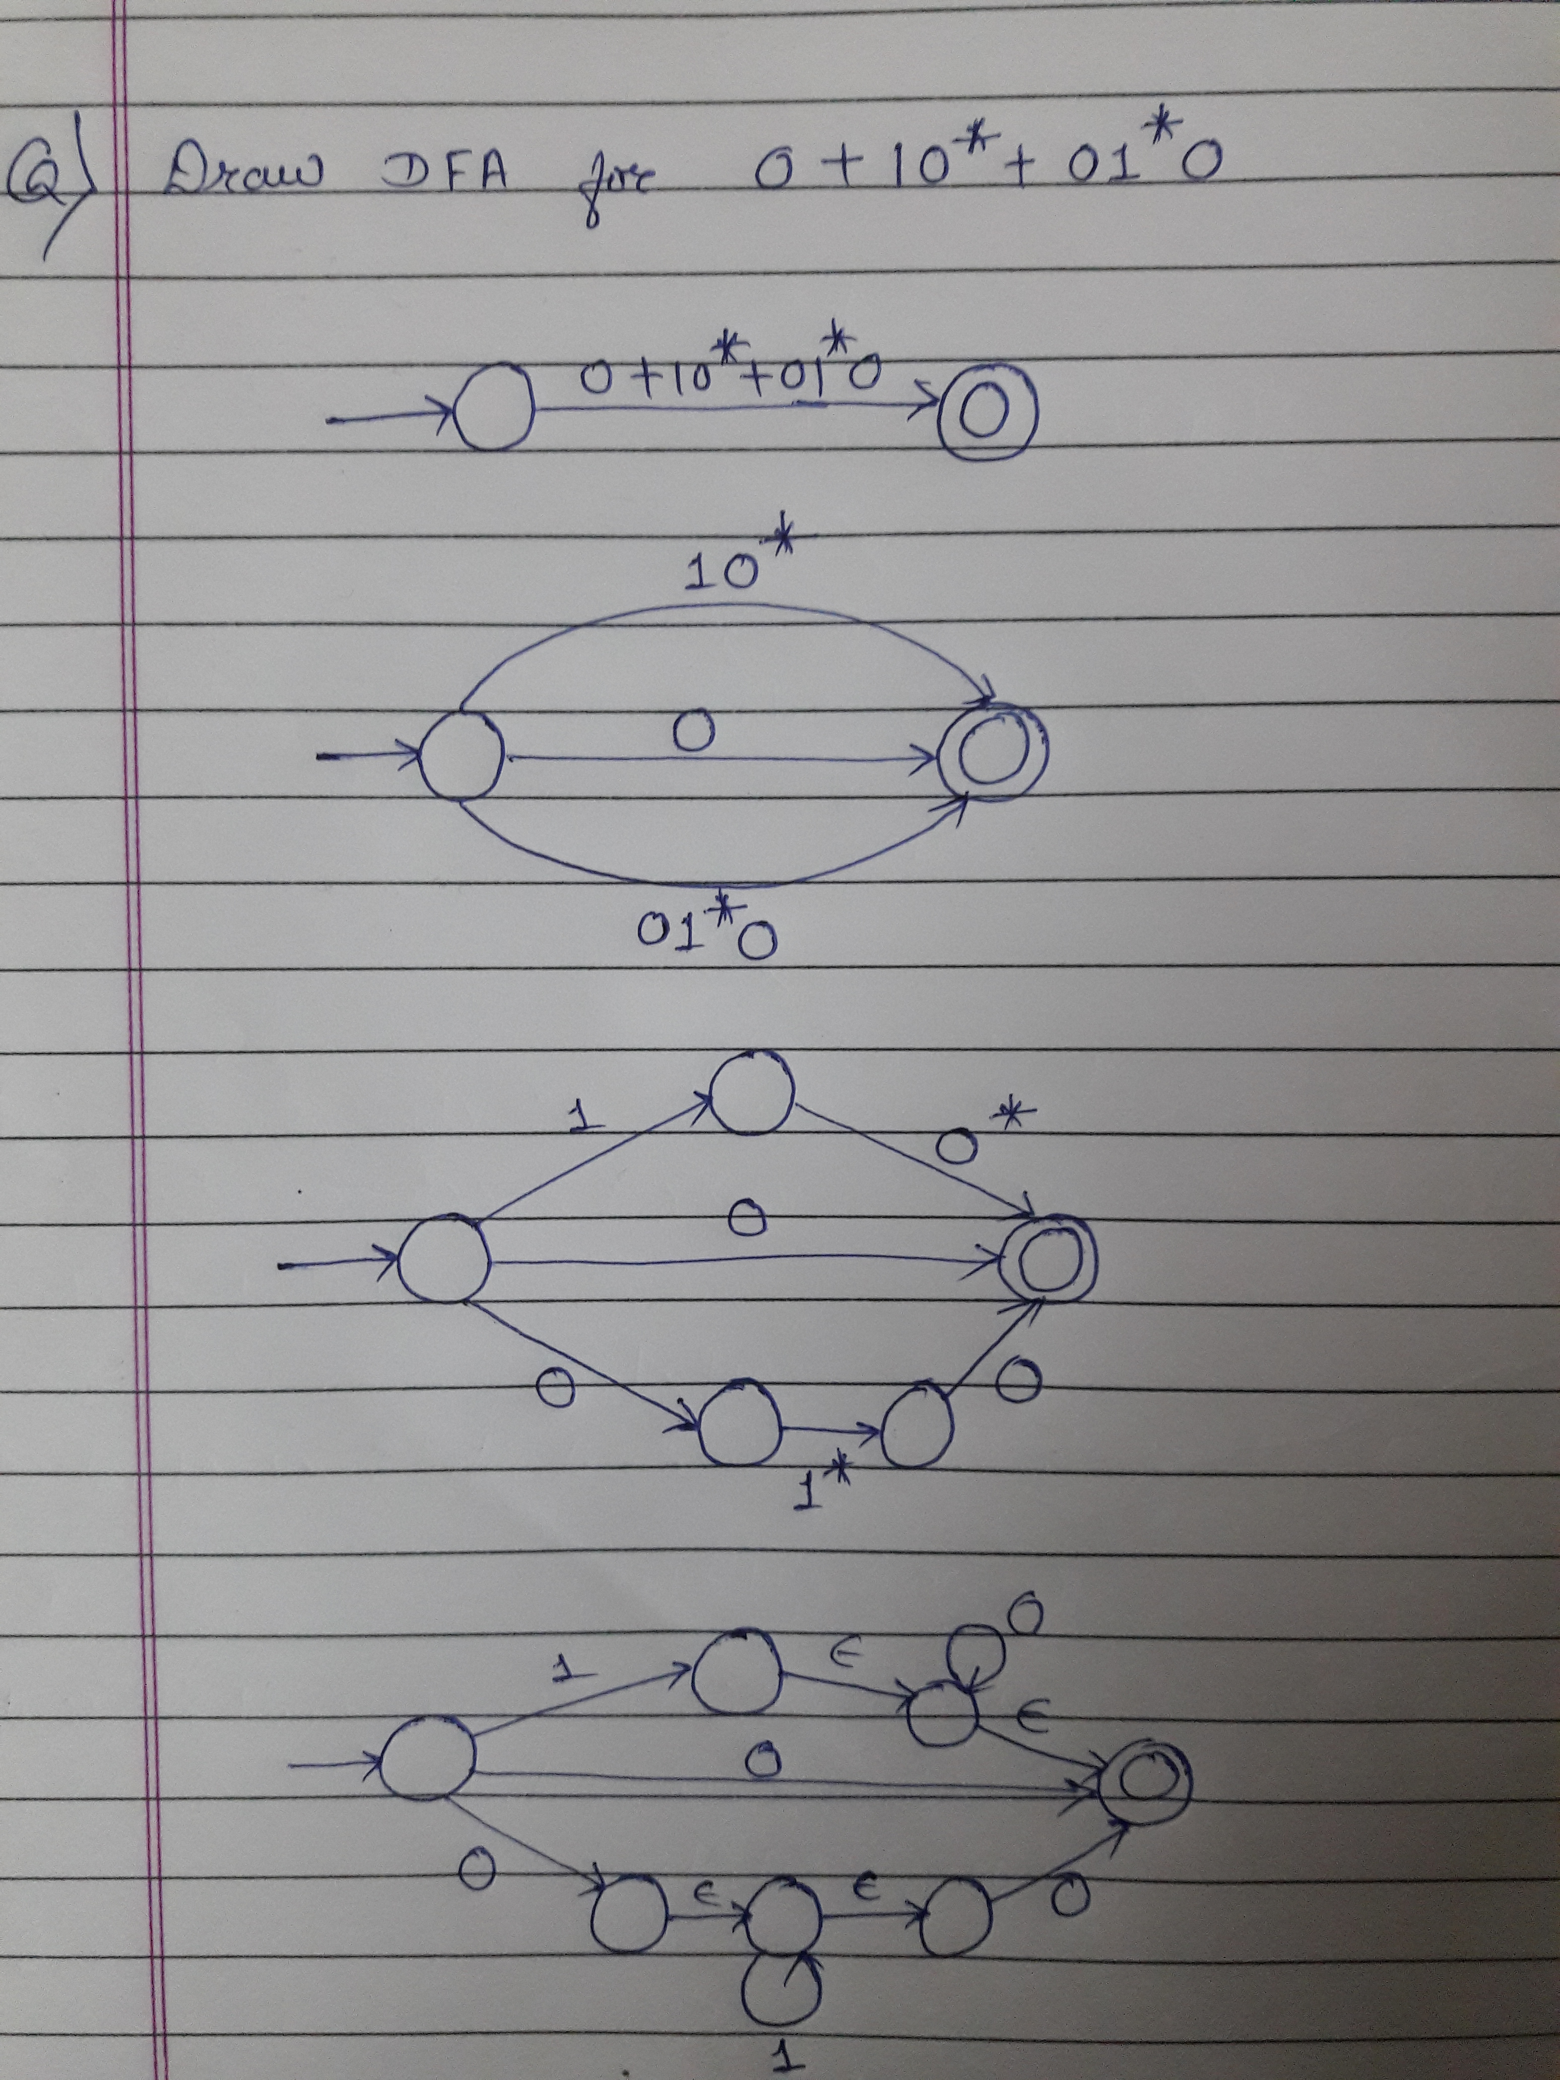

Slide 13
Home work
10+(0+11)0*1
(1+10+110)*0
01[((10)*+111)*+0]*1
1(1+10)* +10(0+01)*
(ab+ba)*aa(ab+ba)*

Slide 14
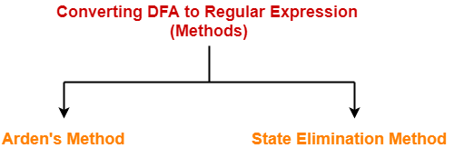

Slide 15
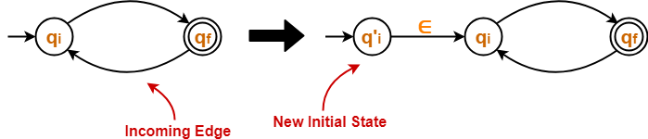
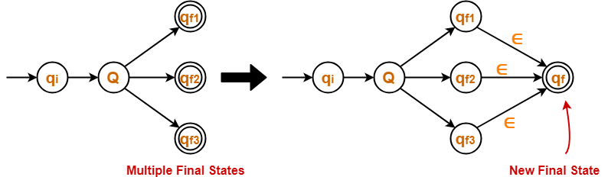
1.State Elimination Method-
Step-01:
The initial state of the DFA must not have any incoming edge.
If there exists any incoming edge to the initial state, then create a new initial state having no incoming edge to it.
Step-02:There must exist only one final state in the DFA.
If there exists multiple final states in the DFA, then convert all the final states into non-final states and create a new single final state.

Slide 16
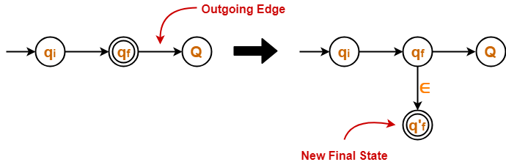
Step-03: The final state of the DFA must not have any outgoing edge.
If there exists any outgoing edge from the final state, then create a new final state having no outgoing edge from it.
Step-04: Eliminate all the intermediate states one by one. These states may be eliminated in any order.
In the end,
Only an initial state going to the final state will be left.

Slide 17
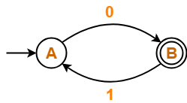
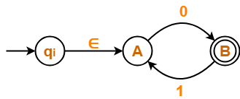
DFA to RE examples
Find regular expression for the following DFA-
Step-01:
Initial state A has an incoming edge.
So, we create a new initial state qi.
The resulting DFA is-

Slide 18
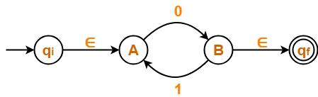
Step-02:
Final state B has an outgoing edge.
So, we create a new final state qf.
The resulting DFA is-

Slide 19
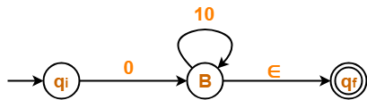
Step-03:
Now, we start eliminating the intermediate states.
First, let us eliminate state A.
There is a path going from state qi to state B via state A.
So, after eliminating state A, we put a direct path from state qi to state B having cost ∈.0 = 0
There is a loop on state B using state A.
So, after eliminating state A, we put a direct loop on state B having cost 1.0 = 10.
Eliminating state A, we get-

Slide 20
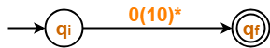
Step-04:
Now, let us eliminate state B.
There is a path going from state qi to state qf via state B.
So, after eliminating state B, we put a direct path from state qi to state qf having cost 0.(10)*.∈ = 0(10)*
Eliminating state B, we get-

Slide 21
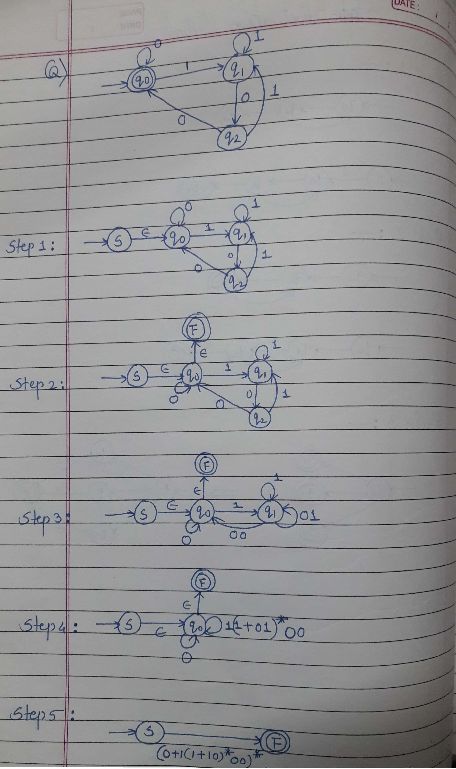

Slide 22
Arden's Theorem
If P does not contain null string, then R = Q + RP has a unique solution that is R = QP*
Proof −
R = Q + (Q + RP)P [After putting the value R = Q + RP]
= Q + QP + RPP
When we put the value of R recursively again and again, we get the following equation −
R = Q + QP + QP2 + QP3…..
R = Q (ε + P + P2 + P3 + …. )
R = QP* [As P* represents (ε + P + P2 + P3 + ….) ]

Slide 23
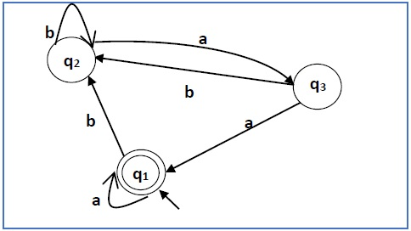
Construct a regular expression corresponding to the automata given below −

Slide 24
The equations for the three states q1, q2, and q3 are as follows −
q1 = q1a + q3a + ε (ε move is because q1 is the initial state0
q2 = q1b + q2b + q3b
q3 = q2a
q2 = q1b + q2b + q3b
= q1b + q2b + (q2a)b (Substituting value of q3)
= q1b + q2(b + ab)
= q1b (b + ab)* (Applying Arden’s Theorem)

Slide 25
q1 = q1a + q3a + ε
= q1a + q2aa + ε (Substituting value of q3)
= q1a + q1b(b + ab*)aa + ε (Substituting value of q2)
= q1(a + b(b + ab)*aa) + ε
= ε (a+ b(b + ab)*aa)*
= (a + b(b + ab)*aa)*
Hence, the regular expression is (a + b(b + ab)*aa)*.

Slide 26
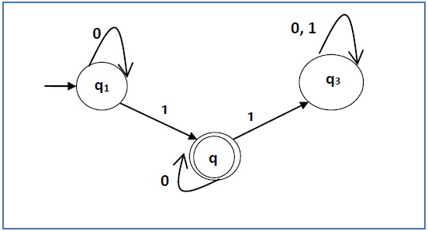

Slide 27
q1 = q10 + ε
q2 = q11 + q20
q3 = q21 + q30 + q31
q1 = ε0* [As, εR = R]
So, q1 = 0*
q2 = 0*1 + q20
So, q2 = 0*1(0)* [By Arden’s theorem]
Hence, the regular expression is 0*10*.

